Slide 1



ALCOHOL DETECTION TO PREVENT ROAD ACCIDENTS

Slide 2
PROBLEM STATEMENT
Consumption of Alcohol is considered bad for our health, as it effects our body parts like liver, in addition to that, driving after alcohol consumption is effecting so many things in the world, a drunk driver who is effecting his/her body by taking alcohol also become a problem for other people and property. A drunk driver does not have enough control over mind to control the vehicle, which leads to accidents causing many deaths, damage of vehicles, damage of properties, in addition to that there can be traffic jams which waste time of millions more people in whole world.

Slide 3
THE EFFECTS OF ALCOHOL ON DRIVING
Increased risk-taking:
Speeding
Failure to wear seatbelt
Recklessness
False sense of confidence and being in control
Difficulty maintaining a constant speed

Slide 4
Surveys of drink and drive cases:
The National Crime Records Bureau (NCRB) data also shows that around 2% of the total road accidents that happen in India are due to drunk driving.
As per the ministry's data, 12,256 road accidents occurred in 2019 which were related to drunk driving, against 12,000 such cases reported in 2018.
In 2019 alone, around 3,000 people lost their lives in road accidents that were related to drunk driving, while 6,675 people were left injured in such drunk driving related road accidents.
A survey in Sri Lanka indicated that for 7% of men, the amount spent on alcohol exceeded their income.

Slide 5
Introduction
The purpose of this work is to avoid drunken driving accident by using alcohol detecting sensor.
The uncontrolled many accidents were happened because of influence of alcohol during driving.
To avoid such accidents, we have proposed alcoholic sensor in the vehicle ignition system. The alcohol sensor detects the presence of alcohol content in human breath. The ignition system will operate based on the level of blood alcohol content (BAC) in human breath detected by the alcohol.

Slide 6
Proposed Work/Solution:
The proposed solution to this problem is to develop a device which will detect the Alcohol consumption of the driver
And if the limits are crossed in terms of alcohol content, then the device will turn off the vehicle to prevent road accidents happening due to alcohol consumption.
In case there are other members in the vehicle who are not drunk , so they can drive the vehicle, if drunk driver is alone , driver can use a website for help where details of his close ones will be there and that will be maintained by an organization or a company which will provide a helper/driver to that drunk one in case there is no one from his provided list to help like if the person is in different city or state.

Slide 7
ALGORITHM:
When the drivers sit on its position in the vehicle i.e. Driver seat , the alcohol sensor will sense the alcohol in its surroundings and send the information to microcontroller
Next, the microcontroller will process the collected information from sensor and confirm if the consumed alcohol content is within limits or exceeding the limits
there will be display of the alcohol content on a LCD display
If the alcohol level is below the threshold amount of alcohol, then vehicle will function normally.
In case, the alcohol content is crossing the limits, then the microcontroller will take the action and break the vehicle’s ignition circuit.
In that condition, if there is any person from passengers eligible of driving the vehicle then that person can take the control
But in case there is no passenger, the driver has to either make a call to a friend, or there is another option, open a website (which will be owned by company or an organization) and there will be simple button for ‘HELP’, and the website will take geological coordinates of the device and information will be circulated to either the emergency contacts added by the user or in case any of the contact is not able to help then the organization will send a person for helping the drunk user.

Slide 8
HARDWARE REQUIREMENTS
POWER SUPPLY
ALRDUINO UNO
MQ3(ALCOHOL SENSOR)
DC MOTOR
BUZZER
LCD DISPLAY
TRANSISTOR

Slide 9
Arduino UNO board -
It is an open source electronic platform based on easy to use hardware and software. It is used for sending receiving and processing the signal and it helps to rotate the dc motor and shows the display on the screen.

Slide 10
DC Motor
Buzzer/Alarm
MQ3 Sensor
DC motor is used as engine starter which would be connected to crank of the engine
A buzzer is a mechanical, electromechanical, magnetic, electromagnetic, electro-acoustic or piezoelectric audio signalling device.
The Analog Gas Sensor-Mq3 Is Suitable for Alcohol Detecting the Sensor Can be used as a Breath Analyzer. It Has A High Sensitivity To Alcohol & Small Sensitivity To Benzene.

Slide 11
LCD DISPLAY
LCD (LIQUID CRYSTAL DISPLAY) screen is an electronic display module & finds a wide range of applications a 16*2 LCD display is very basic module.
The Reasons being LCDs are economical, easily program & have no limitation of displaying special & even custom characters (unlike in seven segments). In this the LCD display is used to show the percentage of alcohol that the sensor has sensed.

Slide 12
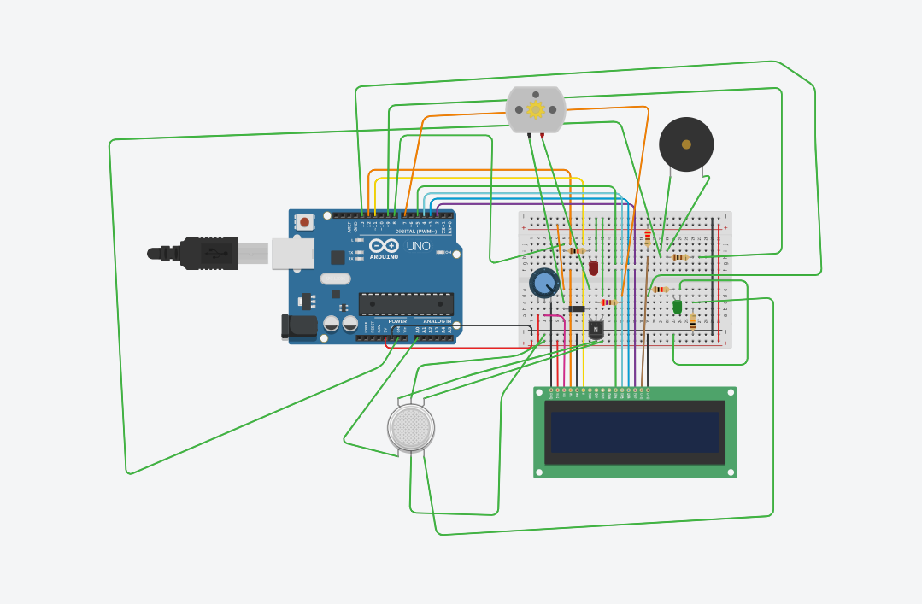
CIRCUIT DIAGRAM:

Slide 13
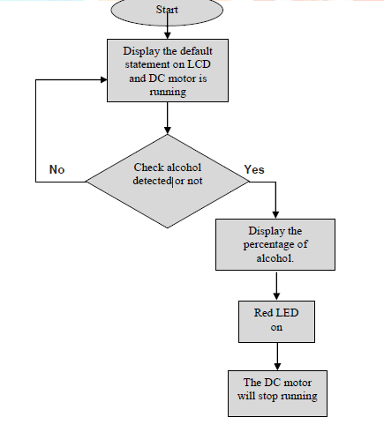
FLOW-CHART

Slide 14
Working of hardware COMPONENTS
Dc motor:- Normally dc motor is in running condition . At that time green led glows & the % of alcohol is less than threshold . But when the % of alcohol will increase above threshold, then the motor will stop and red led will glow.
MQ-3 Sensor: - MQ-3 sensor is used as an alcohol sensor. It senses the % of ethanol molecule. When the % of ethanol will increase above the stated value, then it gives a signal to Arduino.
Arduino board: - It is an embedded system which we used for controlling the whole section. According to the signal of alcohol sensor it controls the working of dc motor. It also controls the LCD display module.

Slide 15
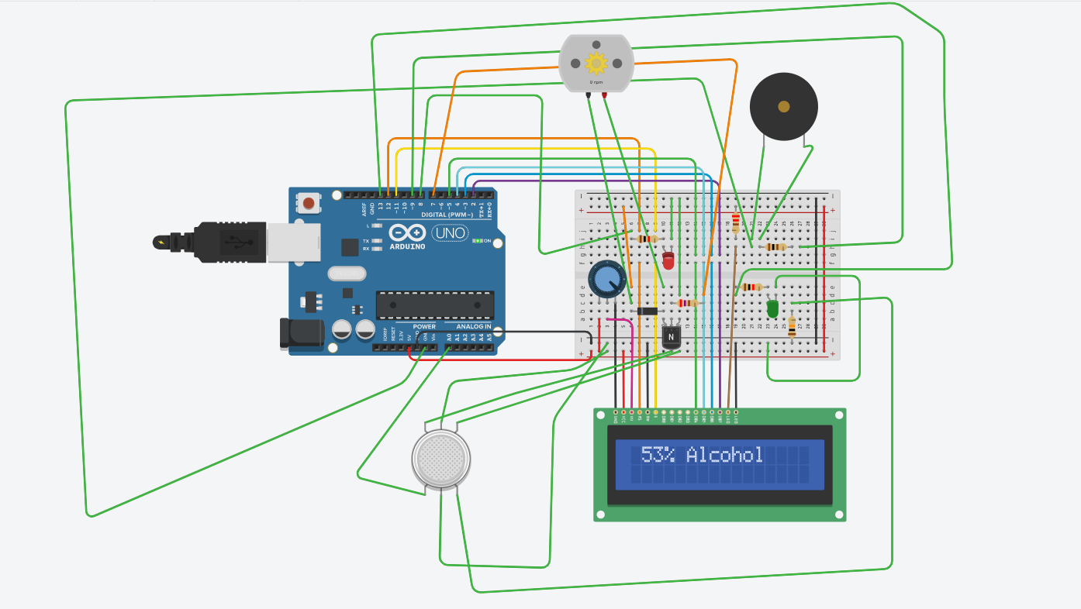
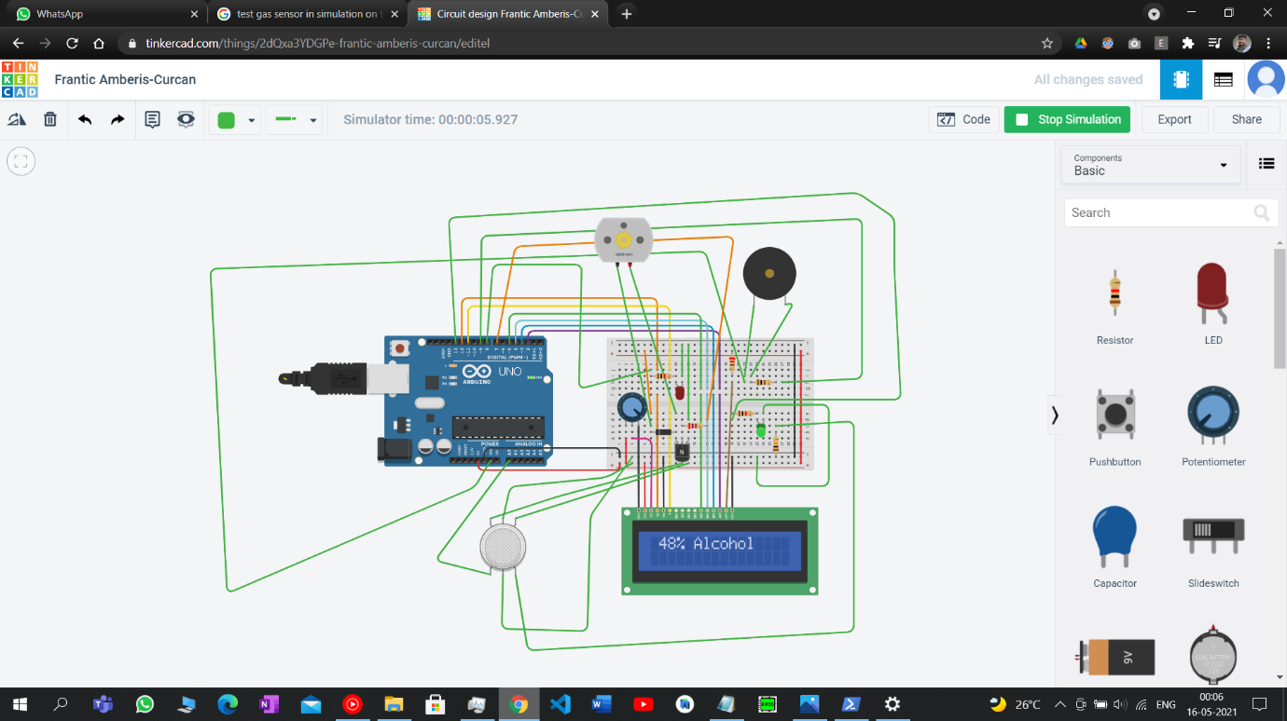
HARDWARE RESULTS
ALCOHOL DETECTED IS MORE THAN THRESOLD VALUE
RED LED TURNED ON
DC MOTOR STOPPED
ALCOHOL DETECTED IS LESS THAN THRESOLD VALUE
GREEN LED TURNED ON
DC MOTOR WORKING NORMALLY

Slide 16
ALGORITHM FOR SOFTWARE PART
The user has to register earlier or before getting help.
At the time of emergency, user have to open the website
There will be only two buttons: Sign In and Sign Up
If user is new, then user have to register
If user has already registered then user can sign IN
When the user is Logged In his geological location will be tracked by the website automatically.
When the location is detected, there will be a button for HELP
When user click that button then the organisation/company have to send their service

Slide 17
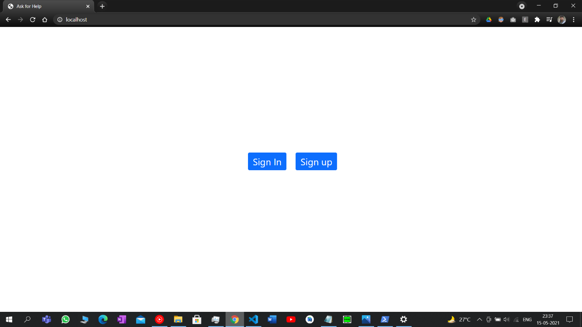
homepage

Slide 18
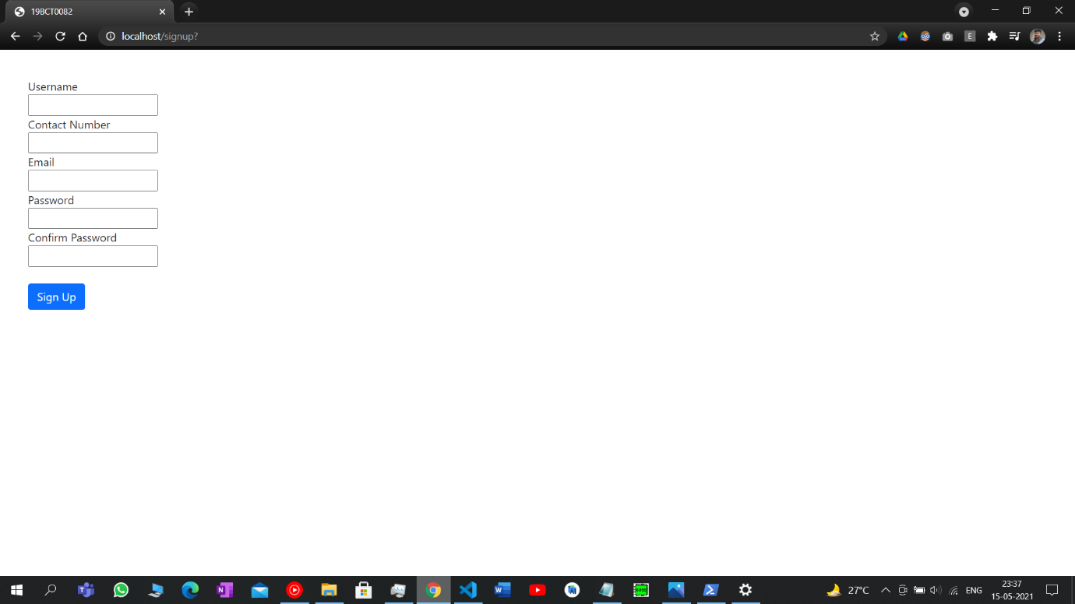
Signup page

Slide 19

Success of registering:

Slide 20
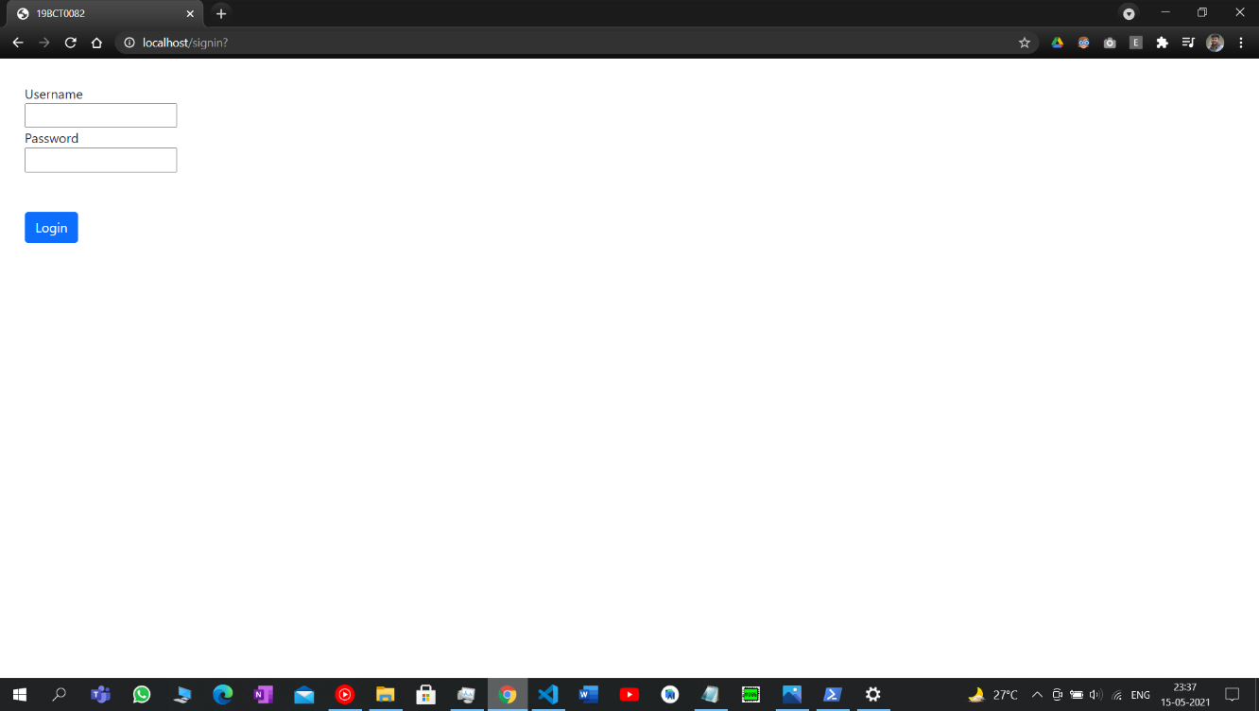
Login page

Slide 21
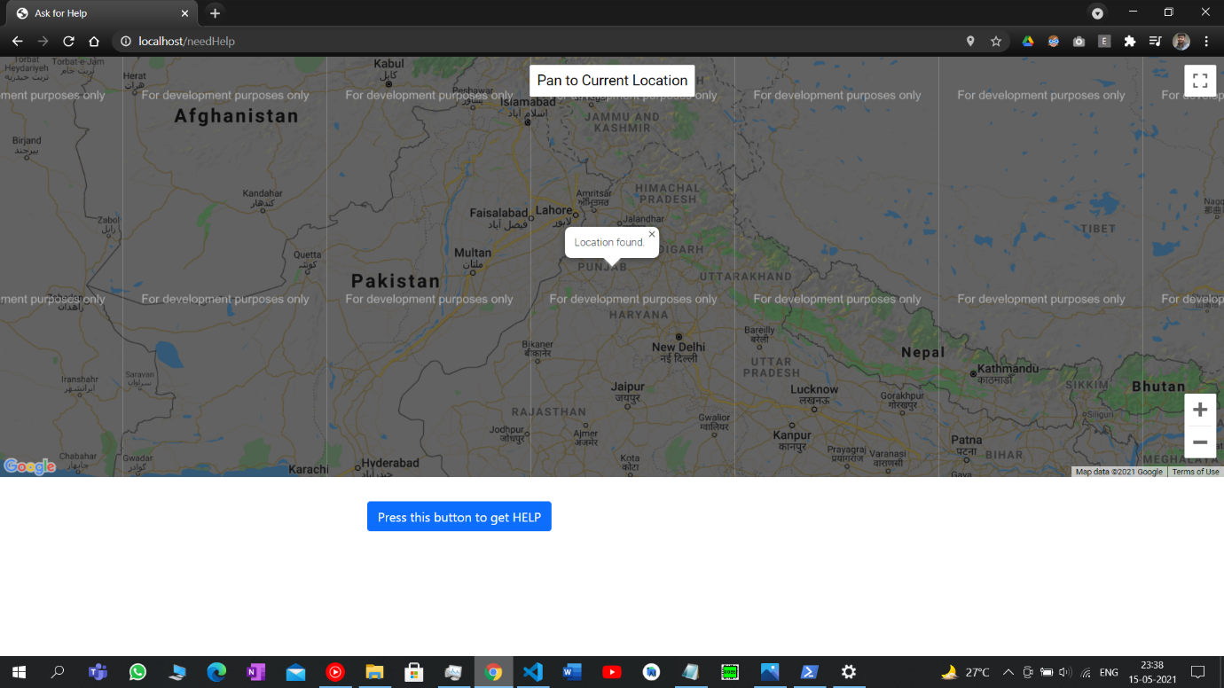
Help page

Slide 22
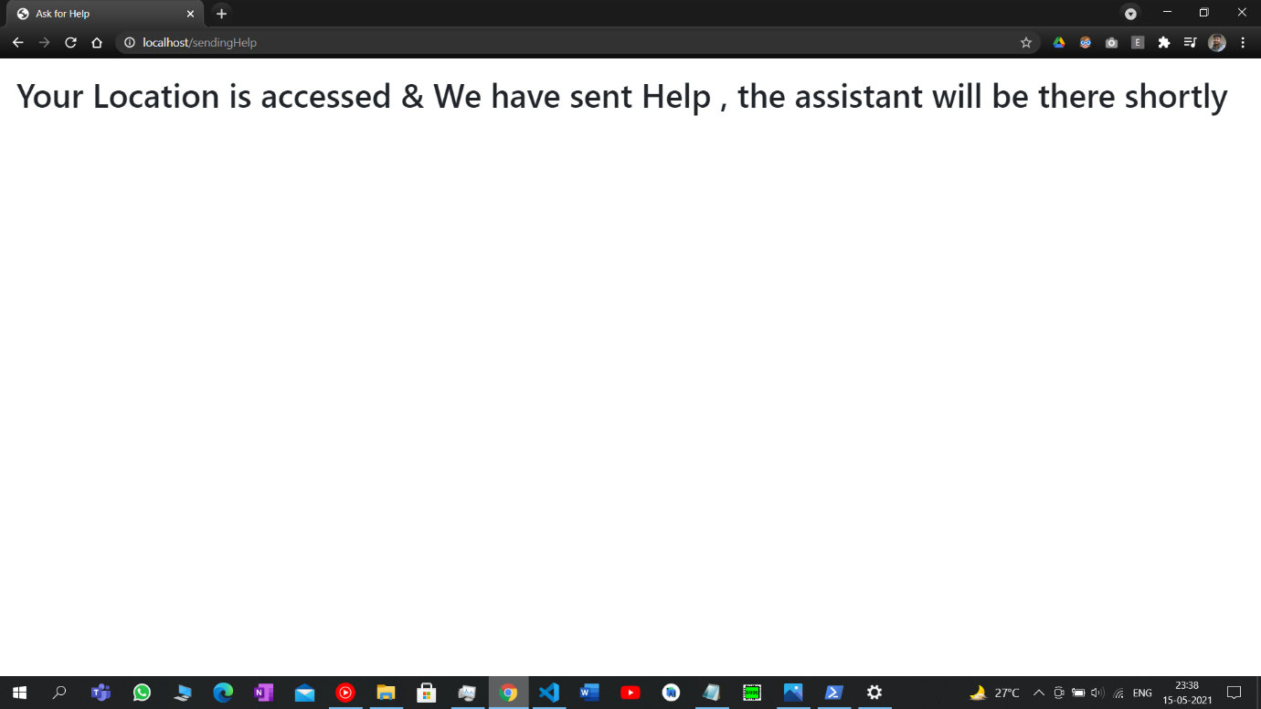
Help sent page:

Slide 23
Future scope
In future we can expect this to be pre-installed feature in vehicles.
The future is of Self driving Cars, so it will automatically turn on self driving mode in case alcohol is detected.
Website can be made much more attractive

Slide 24
CONCLUSION
This Drunk Drive Detection system is combination of an economically effective and technology. The main unit of this project is associate “Alcohol sensor”. If the person within automobile has consumed alcohol then it's detected by the sensing element. sensing element provides this signal to a microcontroller. The microcontroller is connected to the DC MOTOR, which will automatically stop. We can conclude that this device will be able to reduce to Road Accidents happening because of drunk driving at a large scale.

